Slide 1
CS106.1 Project Proposal

Slide 2

Project
The Library Information System (LIS) project aims to create a system that creates a much more efficient and streamlined workflow in all in-house functions of a library, including member management, book transactions (borrowing and returning), and bookkeeping (replacement and addition of new books). The system enhances the efficiency of library employees and members, providing a catalogue and information to members to give an index to their borrowing decisions as well enhance User Experience. The system enables library staff to maintain an up-to-date record, ensuring that members have access to the latest information.

Slide 3

Goals and Objectives
Design and develop a comprehensive system that manages all in-house functions of a library.
Perform basic library activities, such as member registration and management, book transactions, and bookkeeping.
Improve the efficiency of library employees and members.
Provide a catalogue and information to members to facilitate their borrowing decisions.
Allow library staff to maintain an up-to-date record to ensure members have access to the latest information.
Create a user friendly and enjoyable experience with good style, format and layout of functions, and rapid response of system.

Slide 4
System Functions
The system allows secure login for administrators and members.
The administrator can access and view books and members' information.
The administrator can add new books to the catalogue and modify existing records.
The administrator can add new members to the system and modify their personal information.
The system logs messages in a "due date" file whenever the due date for a loaned book is approaching.
The system logs messages in an "overdue" file whenever a book is returned past its due date.
Members can view the catalogue along with availability.
Members can pre-book books.
The system logs messages in a "return" file whenever a book is returned.
These features help the library to efficiently manage its resources and provide better service to its members.

Slide 5
Project Constraints
Due to the short timeline of only 2 days for the Library Information System (LIS) project, there are several potential areas where the lack of time for testing and iterative design could affect the quality, credibility, and reliability of the proposed ideas for addressing the project's problems and needs. Lack of thorough testing: there may not be enough time to thoroughly test the system, which could lead to issues that go unnoticed.
Incomplete or insufficient requirements: it may not be possible to fully identify and document all of the functional and non-functional requirements for the system, which could result in missing or incomplete features.
Limited opportunity for iterative design: it may be difficult to iterate on the design and make improvements based on feedback or testing. This could result in a less optimal user experience and user interface.
Inability to identify all potential design problems: it may be difficult to identify all potential design problems and areas for improvement, which could impact the quality of the final product.

Slide 6
Responsibilities
As the sole team member tasked with creating the Documentation for the Library Information System widget application, I am responsible for fulfilling the following roles:
Project Manager: Manage the project by defining its goals and objectives, creating a timeline, and assigning roles and responsibilities to team members.
Software Architect: Select the appropriate software process model based on the project goals and constraints and explain the reasoning to the team.
Developer/Programmer: Select the right tools, technologies, IDEs, and programming languages that meet the project's requirements and constraints.
Quality Assurance (QA) Engineer: Create testing plans and protocols to ensure the software meets the requirements.
User Experience (UX) Designer: Design the UI/prototype for the software system, including sketches, wireframes, and hi-fi prototypes.
Requirement Analyst: Analyse and document the functional and non-functional requirements, organize and prioritize them, and obtain formal approval from the client or tutor.
User Researcher: Conduct user research by using techniques such as interviewing and ethnographic research to elicit requirements from clients and create user stories and scenarios.

Slide 7
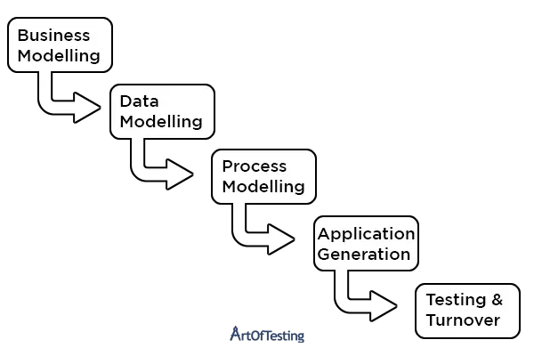
Software Process Model
In order to complete the Library Information System (LIS) project within the tight timeline, I will be utilizing a combination of fast software process models, including Rapid Application Development (RAD), Kanban, and Agile methodologies. These process models are well-suited for fast-paced, iterative development and emphasize, flexibility, and continuous improvement.
Using RAD, an agile software development approach, is ideal for a short timeline project, as it focuses on rapid prototyping and iterative design to quickly produce a functional product.
Implementing Kanban, a project management method that uses visual cues to represent work items and their progress, will promote continuous delivery, reduce work in progress, and help to ensure the project is completed on time.\
The Agile Methodologies that I will be inheriting in the duration of the project is Scrum and Lean are popular agile methodologies. Scrum emphasizes collaboration, flexibility, and rapid iteration through breaking down the project into manageable tasks and working in sprints. This allows for continuous refinement and daily meetings ensure progress. Lean emphasizes continuous improvement and waste reduction by eliminating unnecessary processes to make development more efficient. It prioritizes delivering value to the customer.

Slide 8
Original Requirements
The original list of functions is longer and divided into categories of functional and non-functional requirements, as well as user experience requirements. For presentation purposes, the list has been condensed into sentences, making it harder to categorize and understand, but easier to grasp.
The system should enable secure login, and allow administrators to manage books and members' information, including adding/modifying records.
The system should log messages in "due date," "overdue," and "return" files for loaned books approaching due date, returned books past due date, and returned books, respectively.
The system should have a user-friendly interface, quick load times, robust security measures, and handle many users without performance issues.
The system should provide a seamless and visually pleasing experience, with clear instructions and guidance for users.

Slide 9



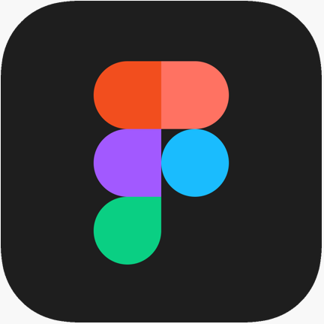

Tools
Word - It will be used for documentation of progress and analysis which will explain the decisions made during the project timeline.
ToDoist - It will be used as a task and project management tool to create, organize, prioritize, and track tasks and goals which is helpful for organizing project workflow and track progress.
Draw.io – It is tool which creates diagrams such as use case diagrams and flowcharts, to help visualize the structure and architecture of the functionality of the Library Information System.
Figma – Is a prototyping software which allows to create low-fidelity (lo-fi) and high-fidelity (hi-fi) prototypes of the user interface for the widget application. This tool will help in creating a visual representation of the system design and gather feedback from potential users.
QT Creator – Is an IDE which will be used to build the widget application for the Library Information System. This is an integrated development environment (IDE) that will provide a suite of tools to facilitate software development.

Slide 10
Requirements Elicitation
Users face challenges with the current library system due to complexity, literacy and technological skills, and difficulty in finding interesting books.
Most users feel the proposed system requirements meet their needs, but some express concerns about data security and admin access.
Users suggest improving the library system with more visual aids, user-friendly interfaces, and better recommendation algorithms.
Important features in a library system include a simple, easy-to-use interface, clear instructions, personalized recommendations, and good customer support.
Key features users want to see in a Library Information System include a clear search function, a wish list, reviews, book reservations, and finding similar books.
Users prefer a simple, modern, visually pleasing design that is colorful, engaging, and has pictures of books.
Login, search, and reserve functions need to be easy to use.
Users expressed varying degrees of concern about security and privacy, wanting robust security measures to protect their data from admin and external threats.
Users expect to use the system on a monthly basis, primarily for searching and recommendations, with some planning to regularly borrow and reserve books.
Most users desire the ability to view popular, new, and recommended books based on their reading history.
Most users value an easy-to-learn and easy-to-use system, although some require additional support.
Some users require assistance, such as clear instructions or a simple interface, to navigate the application.

Slide 11
Requirements Specification
Final Requirements
Data Requirements
Terms and Conditions
System Models

Slide 12
Requirements
The system should allow members and admins to log in and out of their accounts with a password and email.
Members should be able to modify their own information.
Members should be able to track the status of the books they have loaned.
Admin passwords should be protected by censoring them when inputted.
Admins should be able to view members' name and age.
Admins should be able to create new member accounts using name, age, phone number, email, and password.
Admins should be able to modify member information with member permission and password.
The system should contain a library of books with title, author, book cover, synopsis, and status.
Admins should be able to add, delete, and modify books in the library.
The system should log and categorize information about loaned and returned books in a database.
Members should be able to view the status of books.
The system should be easy to use and have a clear and consistent visual design.
The system should be secure and prevent unauthorized access.
The interface should be intuitive and easy-to-use with easy-to-follow navigation.

Slide 13
Data Requirements
User data: This includes information about users such as their name, age, email, phone number, account type (admin or member), and password.
Book data: This includes information about books such as title, author, book cover, synopsis, and status (available, on loan, overdue, or returned).
Borrowing data: This includes information about book borrowing transactions such as the borrower's ID, the book's ID, the borrowing date, and the due date.
Overdue data: This includes information about overdue book borrowing transactions such as the borrower's ID, the book's ID, the borrowing date, and the overdue date.
Help data: This includes information about help requests submitted by users such as the user's name, email, phone number, and help message.
Log data: This includes information that is automatically logged by the system such as the name of the member, book loaned to member, date loaned, expiry date of loan, name of book and date returned, and information about books that are overdue.
Recommended book data: This includes information about recommended books managed by an admin.
Reservation data: This includes information about book reservation transactions such as the borrower's ID and the book's ID.

Slide 14
Terms and Conditions
Personal information will be collected during registration and kept confidential.
User data will be protected but users are responsible for their own data.
Borrowed books will be tracked, and late fees may apply if books are not returned on time.
Book availability is not guaranteed due to high demand or other circumstances.
Account access will not be granted without permission, and users are responsible for keeping their account details confidential.
Contact information will be used for library account communication only and users may opt-out of non-essential communication.
Users are expected to behave in a respectful and courteous manner.
Users are responsible for their account and prohibited from sharing login credentials.
Fees may be charged for late returns or lost books and accounts may be suspended for non-payment of fees.
The terms and conditions may be modified or updated, and users will be notified of changes.

Slide 15
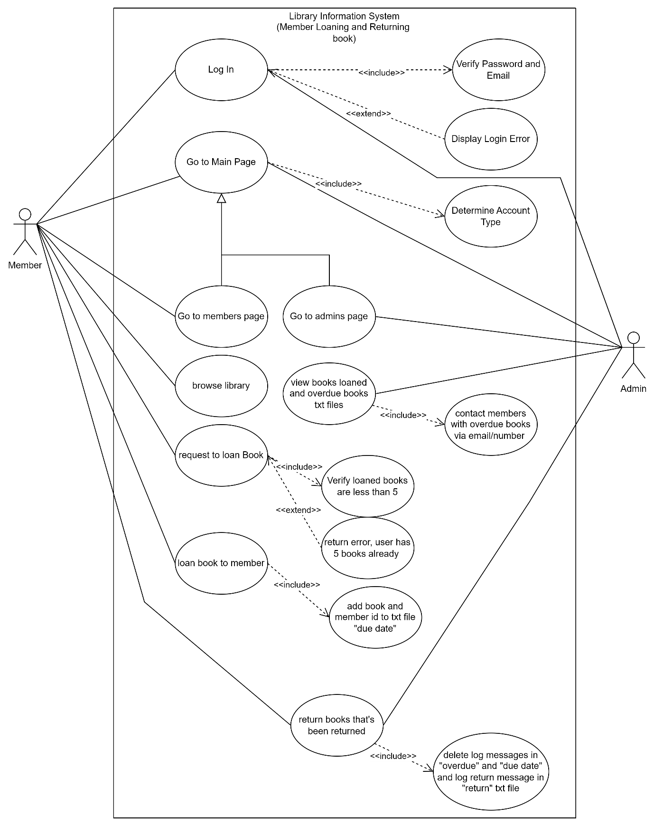
Member Loaning and Returning Use Case

Slide 16
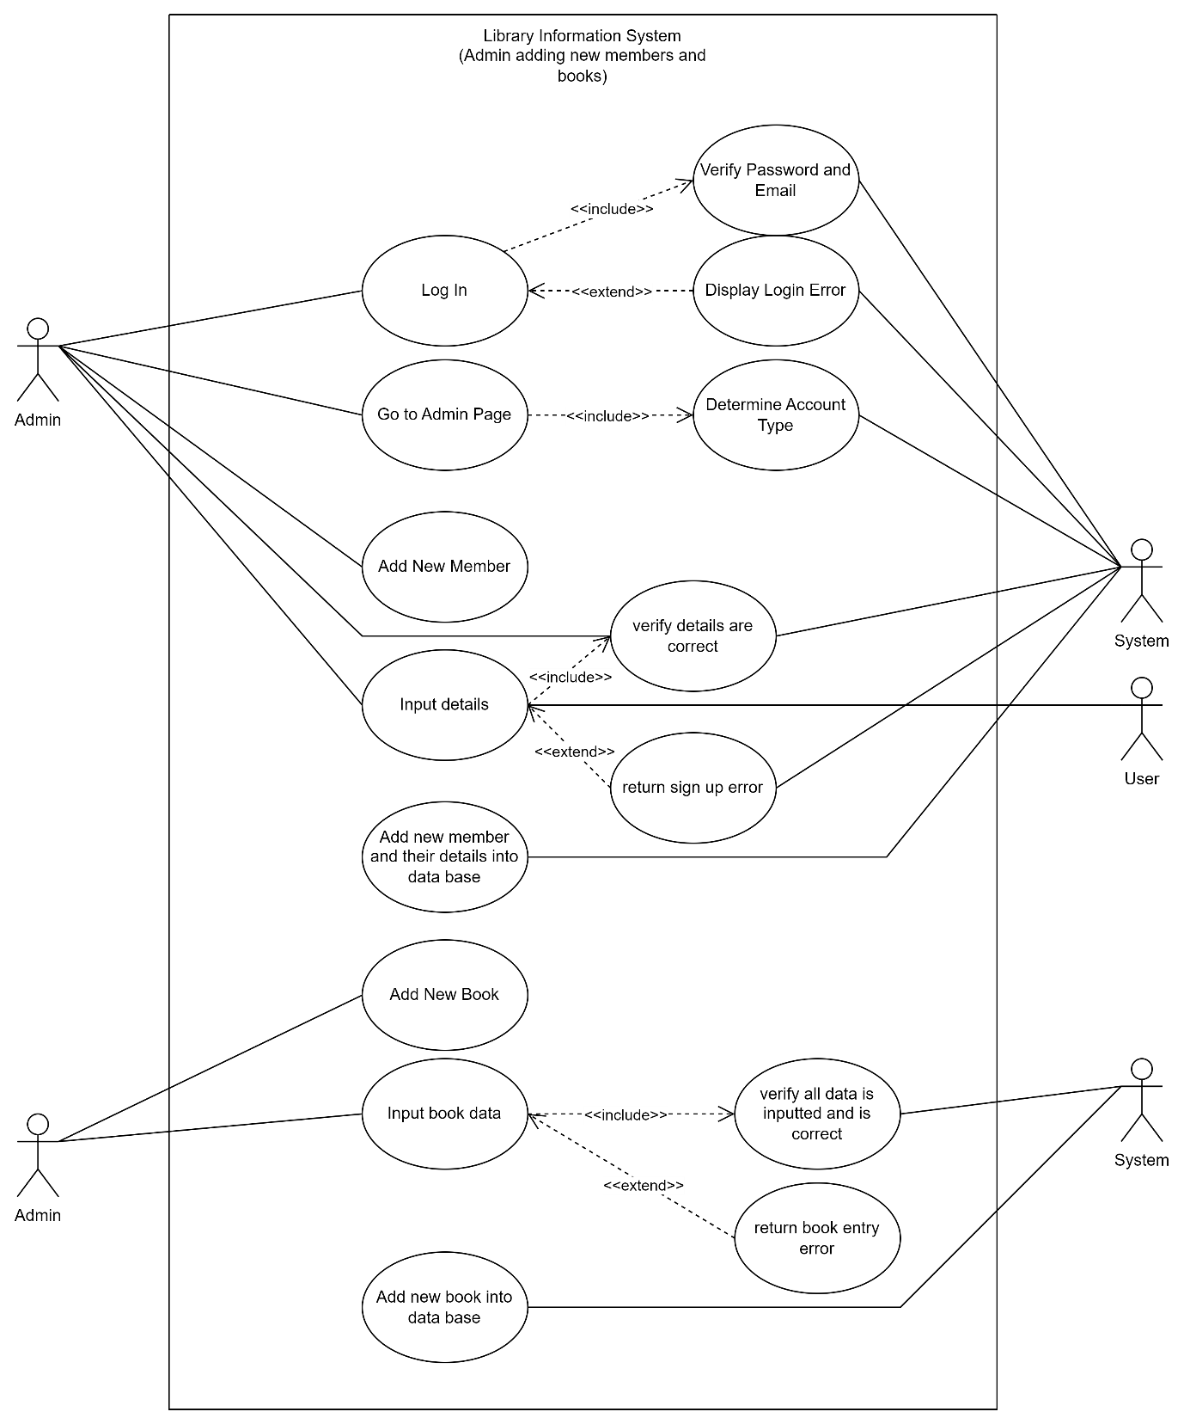
Admin adding new members and books use case

Slide 17
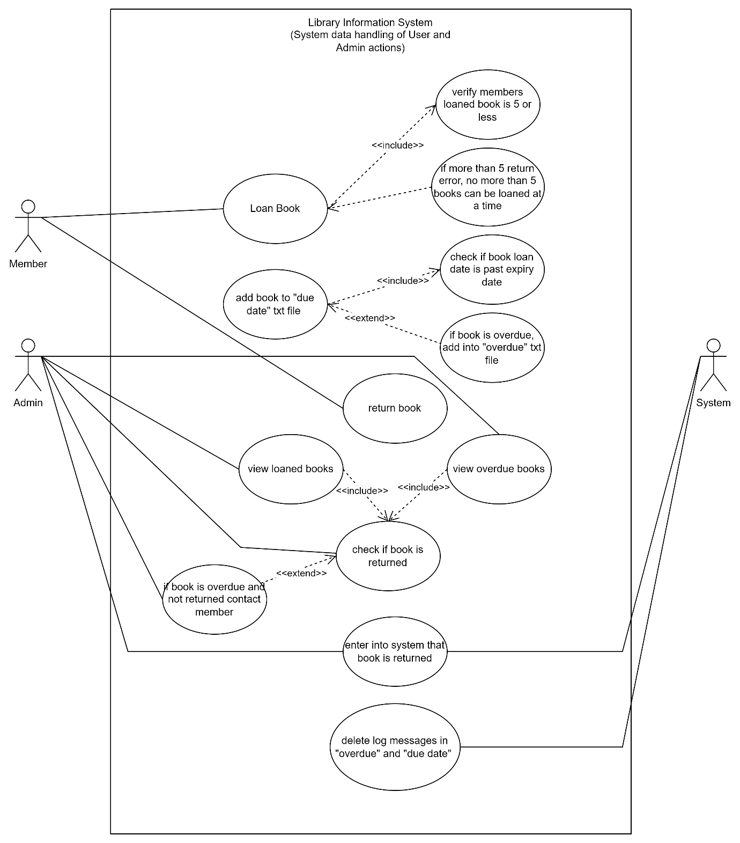
System data handling of User and Admins actions Use Case

